Slide 1
Capstone of Geoffrey Leigh
Statistics & Modeling
Coding with Performance on Big Data
Communicating Results for Decision-Making
Venn Diagram of Data Science Skills
Notes:
Before I Start, I just want thank you all for this opportunity to showcase my Capstone.
It’s been a long road that started in 2014. My Capstone will be About pollution. Looking at this Diagram (show the area where I had the most trouble and why)
Then Talk about the ideal Project that I wanted to achieve using SQL and then talk about the scale back.

Slide 2
Contribution of Competitor’s Article
Title: Particulate air pollution as a predictor of mortality in a prospective study of US adults.
Authors: CA Pope III, MJ Thun, Mohan M Namboodiri, DW Dockery, JS Evans, FE Speizer, CW Heath Jr
Methods: Uses Time-series, cross-sectional, and other studies using between mortality and particulate air pollution
Data: Deaths were ascertained through December, 1989.
Exposure to sulfate and fine particulate air pollution, which is primarily from fossil fuel combustion, was estimated from national data bases.
Summary: US adults found significant associations between
lifetime exposures to Sulphate aerosols and fine particles, as judged by community air pollution data, and some causes of mortality.
Conclusion: It reinforced earlier findings of significant associations, on a daily basis, between exposures to fine particles and mortality, and showed that cardiopulmonary and lung cancer mortality were significantly related to particulate air pollutants.
Notes:
One of the difficult items in the project were to find a recent article relating to my topic using time series analysis. My competitor used cross sectional analysis. Tried to distinguish between car, buses and other factors similar to motor vehicle.
The data focused on Sulfates and PM while I focused on Carbon and ozone, nitrogen, sulfates and PM.
I wanted to keep it high level. These might not be ideal conditions to build a hospital/school due to high levels of the variables.

Slide 3
Description of Your Contribution
Using Time Series Analysis to make a prediction from historical data supplied from sensor data.
From the aggregated dataset, separate the time into 3 categories: Morning (6am to 2pm), Midday (2pm to 10pm) and Night (10pm to 6am) from one sensor station.
Build a program to create a binary prediction (one week forward).
Create a visualization that can be easy to understand to the general public
Notes:
Cross validation: I split my data into 2/3 training data and 1/3 test data for my model.
I used linear regression and carbon as Y dependent variable and PM, sulfate, nitrogen and Ozone as independent variable.
When I aggregated my data, I split the data into morning, midday and night from the sensor station. I broke it down in weeks instead of months. This made it easier for me to do a predict. Using historical data I was able to train the model to do a prediction that is easy to understand. I also created a binary to distinguish what was high levels of pollution and what was safe.

Slide 4
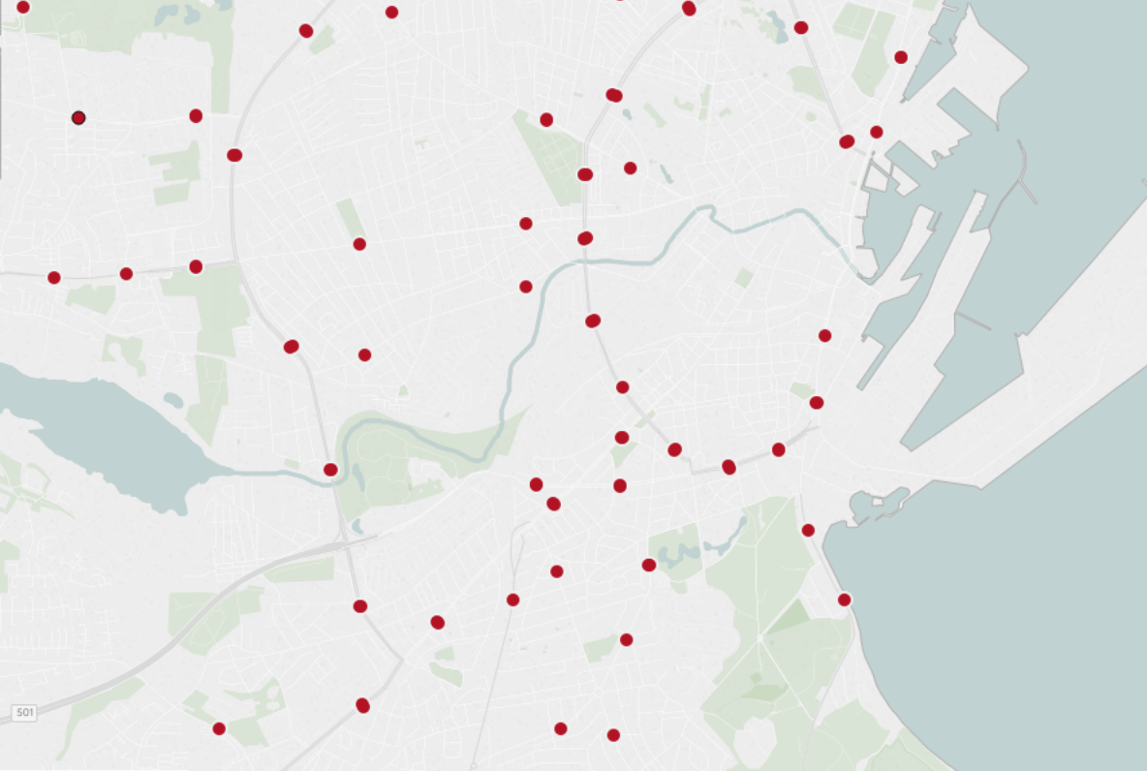
Data Source and Content
Dataset supplied by: http://iot.ee.surrey.ac.uk:8080/datasets.html
Variables: Carbon Monoxide, Particulate Matter, Sulfate Dioxide, Nitrogen Dioxide
Observation points: ~449
Location: Denmark
Date Range: August 2014 - October 2014
Time cycles: 24hrs periods
Carbon Monoxide – CO
Primary pollutant, emitted by incomplete combustion of biomass or fossil fuels
Emissions reduction by higher temperature combustion and use of catalytic converters on motor vehicles
Nitrogen Dioxide – NO₂
Formed by oxidation of NO, which is produced with high temperature combustion (NO₂ is a secondary pollutant)
Sulfur Dioxide – SO₂
Primary pollutant, emitted by combustion of fuels containing sulfur; also metal smelting
Particulate Matter - PM
Products of combustion, atmospheric reactions, and mechanical processes
Wide range of particle sizes
Notes:
The data came from Europe where there were 449 stations the measured 5 variables.
The time frame was August 2014 to October 2014. The station took constant readings for 24 hour periods.

Slide 5
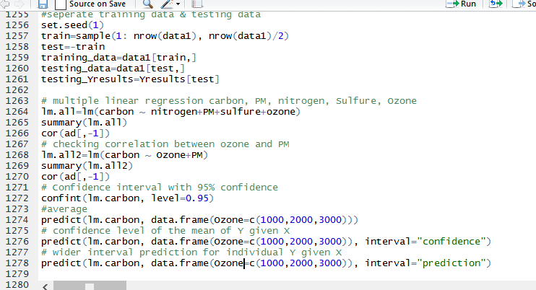
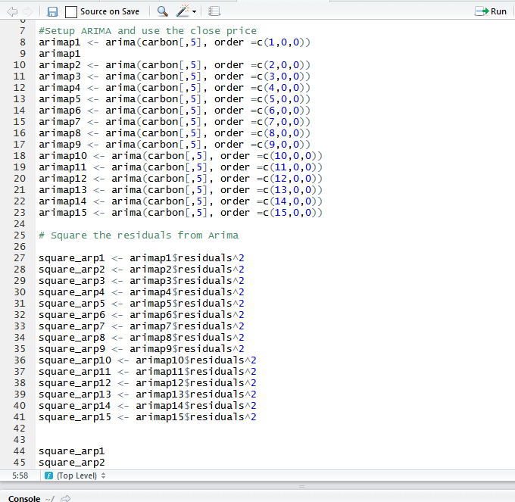
Your Method
Upload the dataset
Normalize it (scale it) equation
Analysis (training, testing and exploring data)
Predict (LM and Time Series Analysis)
ARIMA: AutoRegressive Integrated Moving Average
Conclusion and Visualization (Make sense of the data)
Future research: Incorporate other data sets to the project (Traffic)
Notes:
Linear Model: Linear regression, we predict scores on one variable from the scores on a second variable. The variable we are predicting is called the criterion variable and is referred to as Y. The variable we are basing our predictions on is called the predictor variable and is referred to as X. When there is only one predictor variable, the prediction method is called simple regression. In simple linear regression, the topic of this section, the predictions of Y when plotted as a function of X form a straight line.

Slide 6
Capstone: Air Pollution Focus
The natural atmosphere
Outdoor pollutants and their sources
Indoor air pollution
Health effects of air pollution
Measurement of particle pollution
Climate change
Notes:
Ozone :
Ozone is a particle of three oxygen molecules bound together (O3). It is flimsy and exceptionally receptive. Ozone is utilized as a detergent, an aerating specialist, and a cleansing operator for air and drinking water. At low fixations, it is dangerous.

Slide 7
Similar to other studies but not as specific
Carbon monoxide (yes)
Sulfur dioxide (yes)
Nitrogen dioxide (yes)
Volatile organics (NO)
Ozone (NO)
Particulate matter (some)
Sulfates, nitrates, organics, elemental carbon, lead and other metals
Notes:
Carbon Monoxide:
CO is a dismal, scentless gas shaped by the fragmented response of air with fuel. CO contamination happens fundamentally from emanations delivered by fossil fuel–powered motors, including engine vehicles and non-street motors and vehicles, (for example, development hardware and vessels).

Slide 8
Nitrogen Dioxide – NO₂
Formed by oxidation of NO, which is produced with high temperature combustion (NO₂ is a secondary pollutant)
Oxidant that can irritate the lungs and hinder host defense
A key precursor of ozone formation
Emissions reductions by engine redesign and use of catalytic converters
Notes:
Nitrogen dioxide is a frightful noticing gas. Some nitrogen dioxide is shaped actually in the air by lightning and some is created by plants, soil and water.

Slide 9
Sulfur Dioxide – SO₂
Primary pollutant, emitted by combustion of fuels containing sulfur; also metal smelting
Irritates upper respiratory tract
Converted in atmosphere to acid sulfates
Emissions reductions by building taller smoke stacks, installing scrubbers, or by reducing sulfur content of fuel being burned
Notes:
Sulfur dioxide is a gas. It is imperceptible and has a terrible, sharp smell. It responds effortlessly with different substances to frame hurtful mixes, for example, sulfuric corrosive, sulfurous corrosive and sulfate particles.

Slide 10
Carbon Monoxide - CO
Colorless, odorless gas
Primary pollutant, emitted by incomplete combustion of biomass or fossil fuels
Binds strongly with hemoglobin, displacing oxygen
Emissions reduction by higher temperature combustion and use of catalytic converters on motor vehicles
Notes:
Excluded this slide from presentation.

Slide 11
Particulate Matter - PM
Products of combustion, atmospheric reactions, and mechanical processes
Wide range of particle sizes
Wide range of physical/chemical properties
Wide range of health impacts, including premature death
Control by filtration, electrostatic precipitation, and reduction of precursor gases
Notes:
Excluded this slide from presentation.

Slide 12
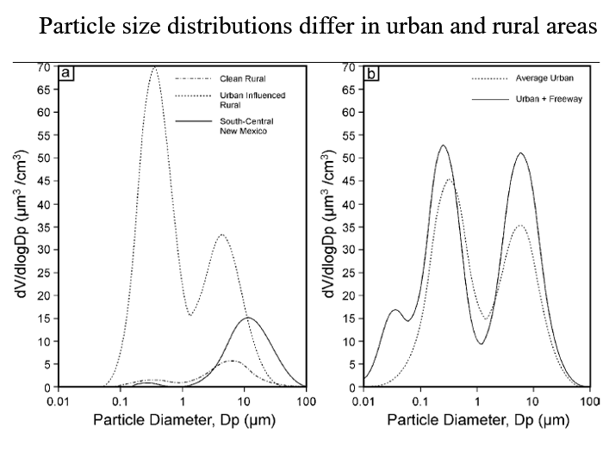
Competitors focus on Urban and Rural
Notes:
Excluded this slide from presentation.

Slide 13
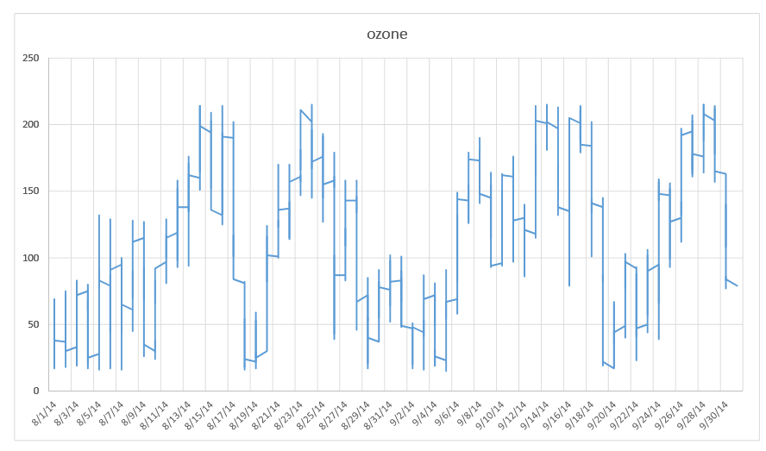
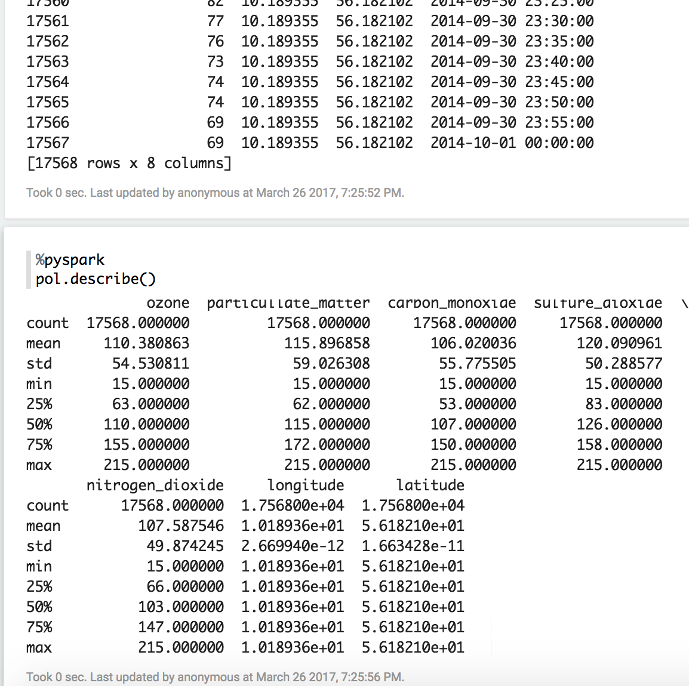
Quantitative Results 1
After many iterations in exploring the data, decided to slice up the data set into weeks and break them up to 3 equal parts: Morning, Midday and Night
Used zeppelin and R to normalize data and get some statistical data. Used describe() function to get my results.
Used Linear Regression model LM function in R, using Carbon as my Y variable and Ozone, PM, Nitrogen and Sulfate as my independent variables.
Then used Times series analysis to see if the following week I could make a prediction.

Slide 14
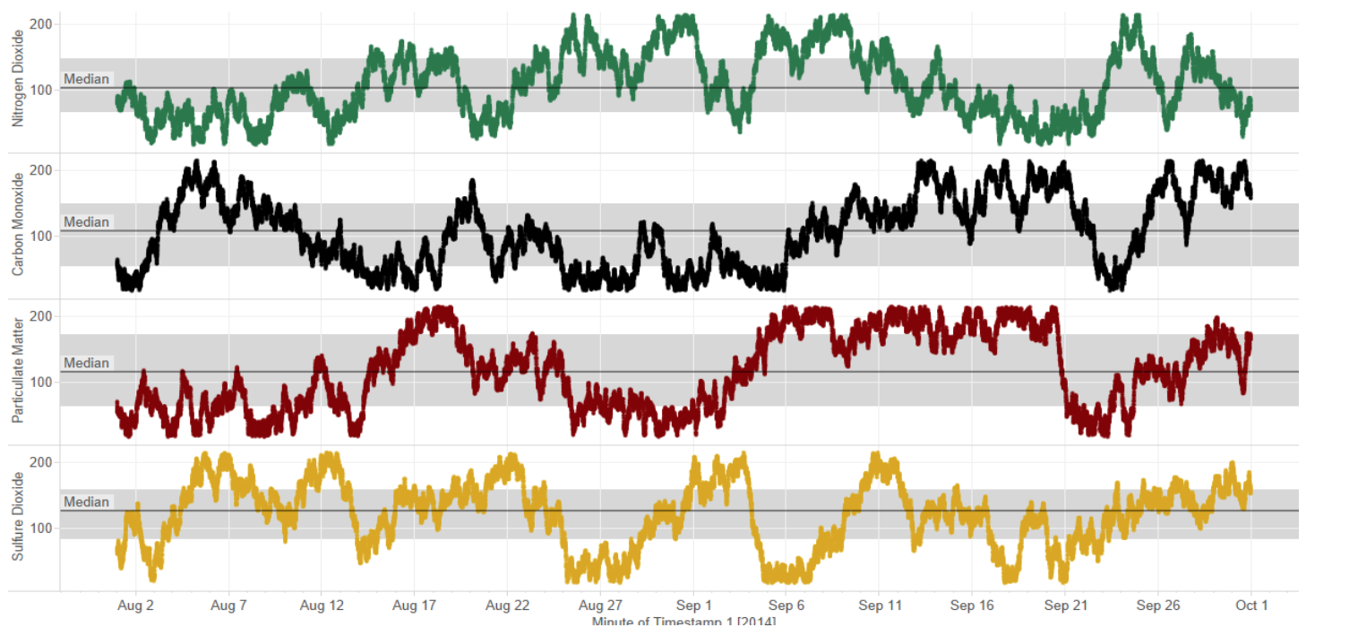
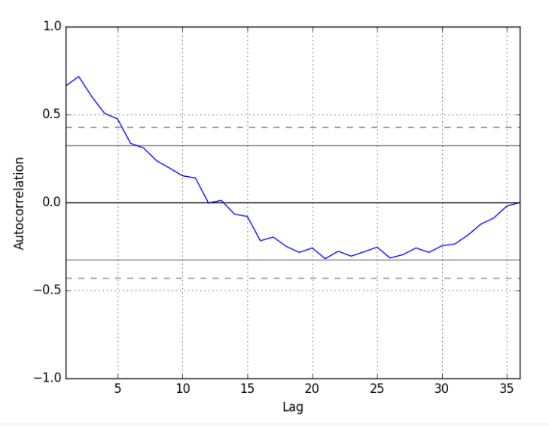
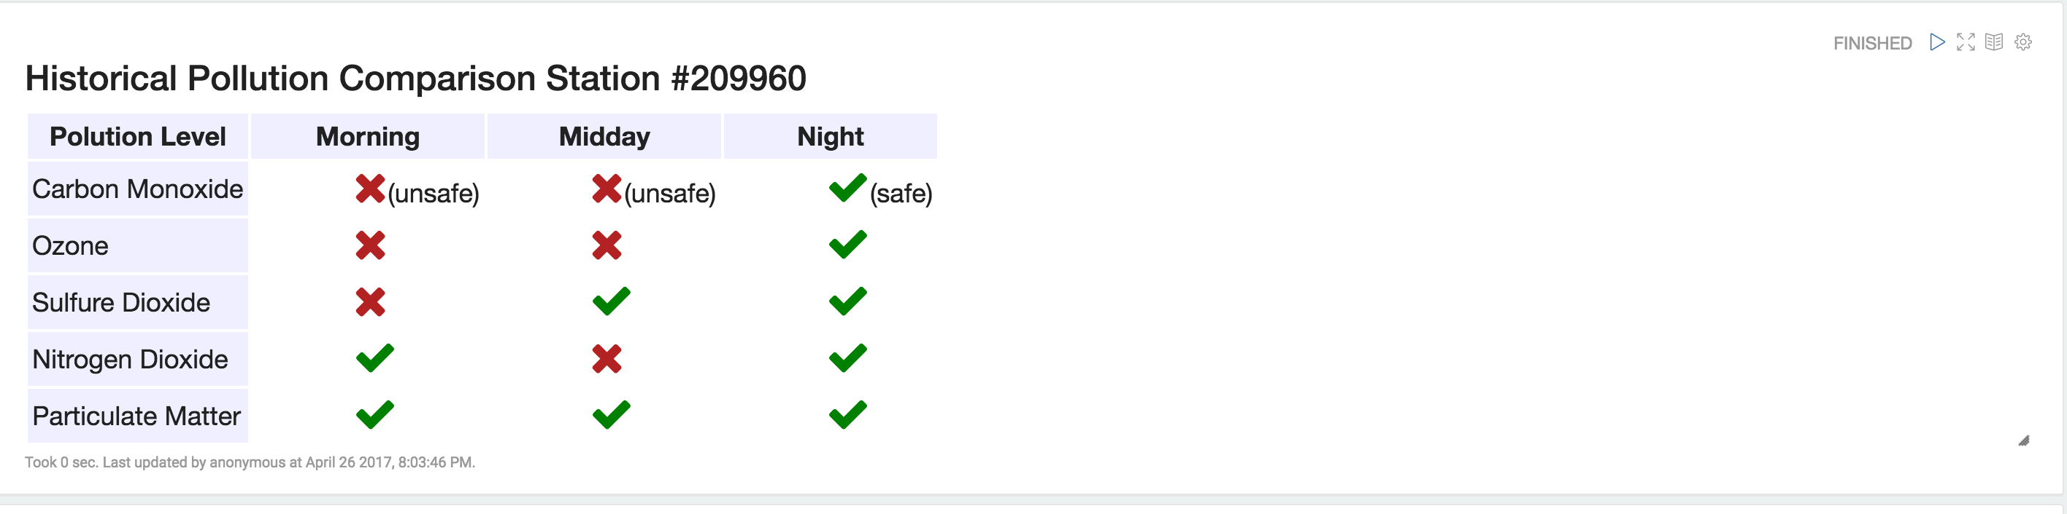
Quantitative Results 2
Normalized the data and plotted both training and test data. Wanted to see how all variables compared to each other.
There is a positive correlation with the first 10-to-12 lags that is perhaps significant for the first 5 lags. A good starting point for the AR parameter of the model may be 5.

Slide 15
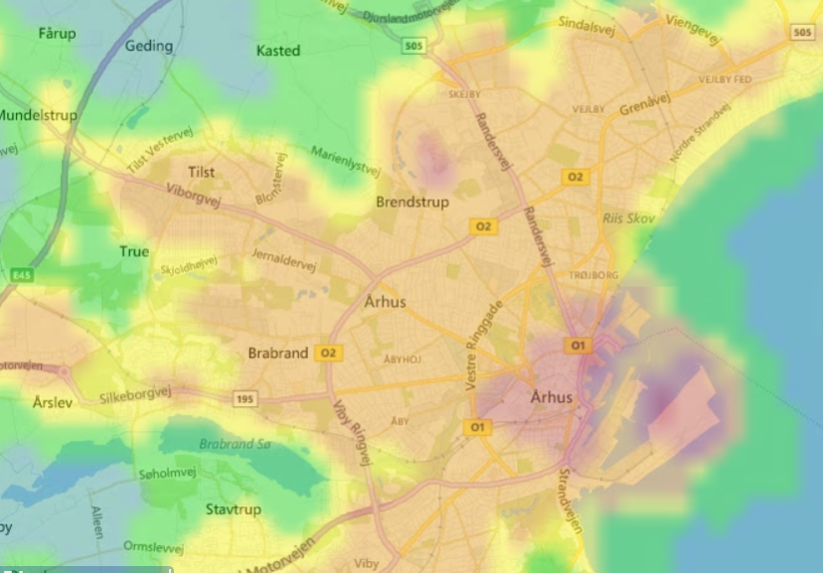
Our study will focus on the area where is the pollutant is most prevalent
Notes:
Excluded this slide from presentation.

Slide 16
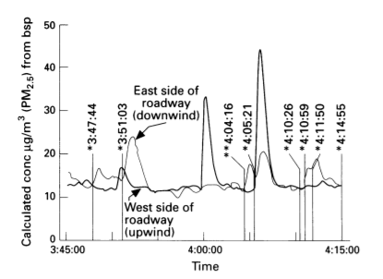
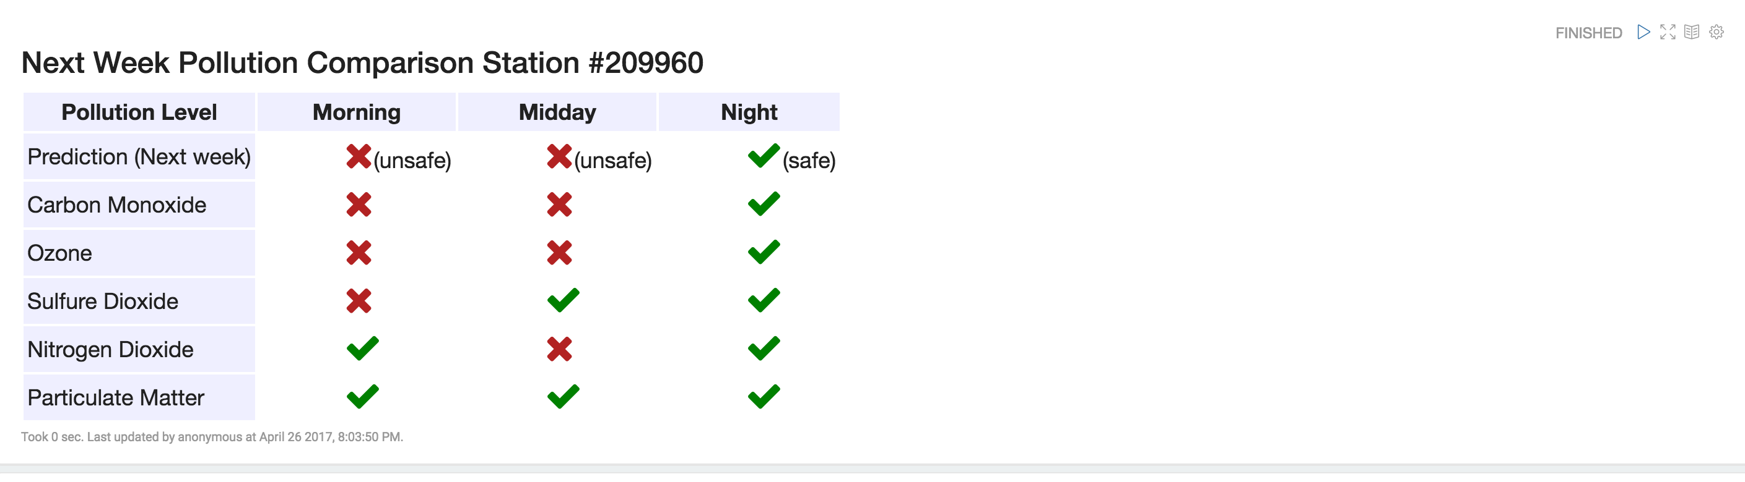
Discussion: Comparison With Your Competitor
Competitor’s Results
Your Results
From historical senor data able to produce a prediction for the following week.
As my competitor focused on mortality rate using pollution, my focus was mainly time of day predications using times series analysis.
Calculations based on these observations suggest that a
diesel bus with a low exhaust emits 50 times more PM2 5
than an automobile.
Spike in difference between a car and a bus going by
Notes:
Talk about the prediction method that I used and how it predicts the next week’s level of pollution.
The accuratcy rate was high and talk about the factors and the weights. Sulfate had a high weight with respect to carbon.

Slide 17
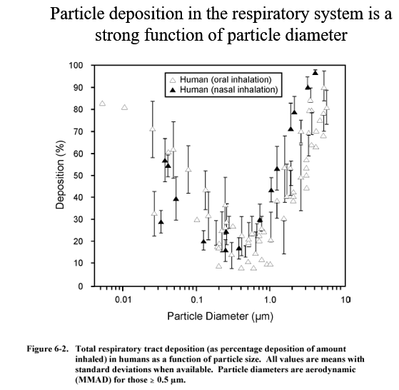
Competitor focus on health effect of pollution
Notes:
Excluded this slide from presentation.

Slide 18
Performance on Big Data: Time Measurements
Uploading data time manually (each csv ~22 sec X ~449 station= too long)
Using Zeppelin, to upload the csv. (3 seconds)
Cleaning dataset (2 mins); data was very clean, no NAs.
*Exploratory data analysis (many hours)
Using R to run analysis on data sections (<15 secs each)
Visualization time when data is uploaded to Zeppelin (1 sec)
Visualization time when data is uploaded to Tableau (25 secs)
Notes:
The Biggest Challenge was exploring the data.
I wanted to fully understand the data and it consumed most of my time.

Slide 19
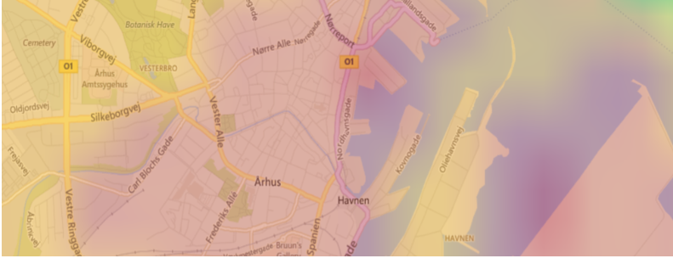
Investigate which routes and time where levels are high
Notes:
Excluded this slide from presentation.

Slide 20
Conclusion
Results: From the pollution data set, the program could make a binary prediction of next week’s pollution forecast (safe or unsafe) based on the historical data provided. Accuracy rate is 0.68 based on the test data.
Future work: using Logistic Regression Analysis on the dataset or other methods.
Use: This would be useful for city planners to determine where are hot spots of pollution within a city and could determine where not to build a school.
Notes:
From the pollution data set, the program could make a binary prediction of next week’s pollution forecast (safe or unsafe) based on the historical data provided. Accuracy rate is 0.68 based on the test data.

Slide 21
Quiz for Your Classmates
What statistical method was used?
What programming tool was used?
What scientific contribution was made?
What idea could be useful for your project?

